Slide 1
R-Ladies Auckland Launch
7th December 2017
library(dplyr)
rladies_global %>%
filter(city == 'Auckland')

Slide 2
Thank you !
Department of Statistics at the University of Auckland for the venue
Data Science Discussion Group for support with the launch
Notes:
Welcome and thank you to Department of Statistics at the
University of Auckland for the venue
and
The Data Science Discussion Group for support with the launch

Slide 3
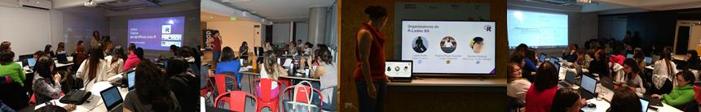
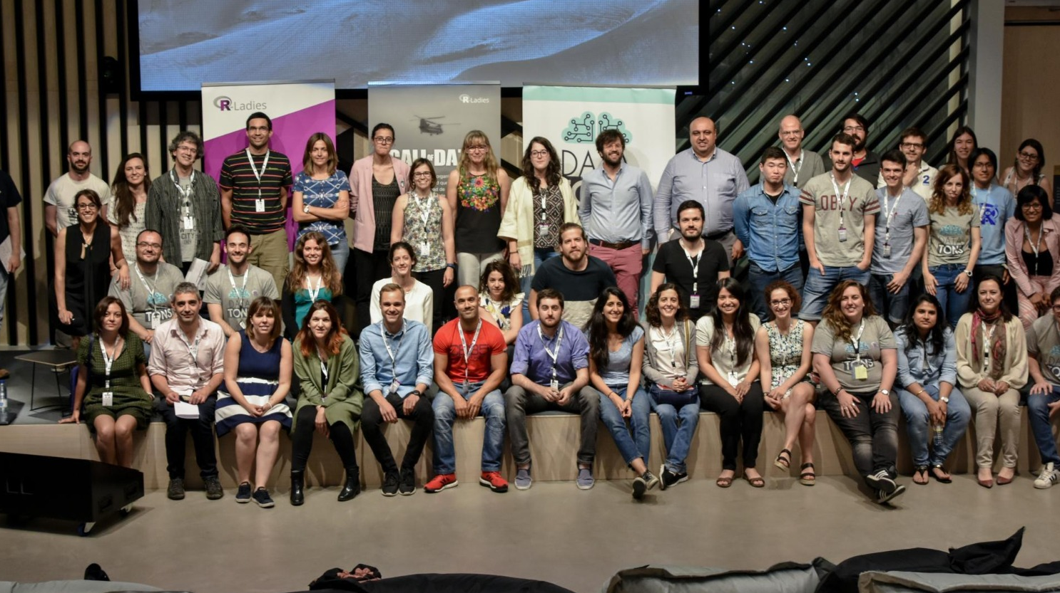
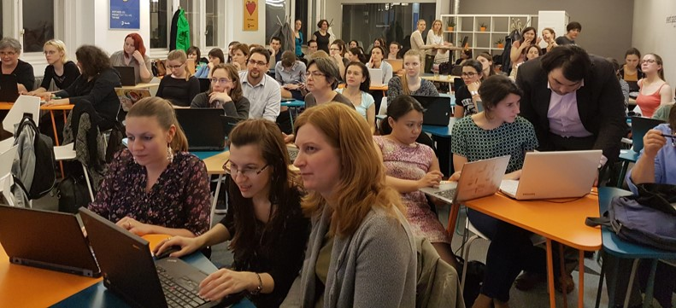
Overview
What is R-Ladies?
What can we do to get
involved?
Hadley Wickham
https://github.com/rladies/rladies_global_presentations

Slide 4

What is R-Ladies?
Worldwide organization that promotes gender diversity in the R community via meetups and mentorship in a friendly and safe environment
In 2012, Gabriela de Queiroz founded the first women-focused R user group in San Francisco.
R-Ladies has
since grown to a
global community
with shared resources
29+ countries
13,400+
members
66+ cities
Notes:
Global R-Ladies is a Worldwide organization that promotes gender diversity in the R community via meetups and mentorship in a friendly and safe environment
The first R-Ladieswas founded in San Francisco In 2012 by Gabriela de Keyroz.
R-Ladies has since grown to a global community in more than 66 cities with shared resources across twitter github and more
I decided to set up an Auckland chapter after dropping in on a meeting in Melbourne in October. The Melbourne chapter welcomes all genders, and so this is also one of the principals of the Auckland chapter,so that we can continue the discussion on diversity.

Slide 5
What can we do to get involved?
Participate
Organise
Venues
Workshops
Presentations
Teach and share
Learn
Inspire
Build community
Spread the word
R-Ladies Auckland Contact Details
Twitter: @RLadiesAKL
Email: auckland@rladies.org
R-Ladies Auckland Meetup Materials
Github: https://github.com/R-LadiesAKL
Notes:
The aim is for R-Ladies Auckland to also have the community spirit and include all R abilities. So what can we all do? Participate and get involved, share your knowledge but also come here to learn.
Build the community and get others involved.
Come up with topics and ideas but also look to the broader communities for inspiration eg R-Ladies Global.
If you have a knack for organising and getting people together then talk to us so we can organise workshops and speakers.
Here are our contact details twitter handle and email address
We will also add materials and projects to this github account.

Slide 6
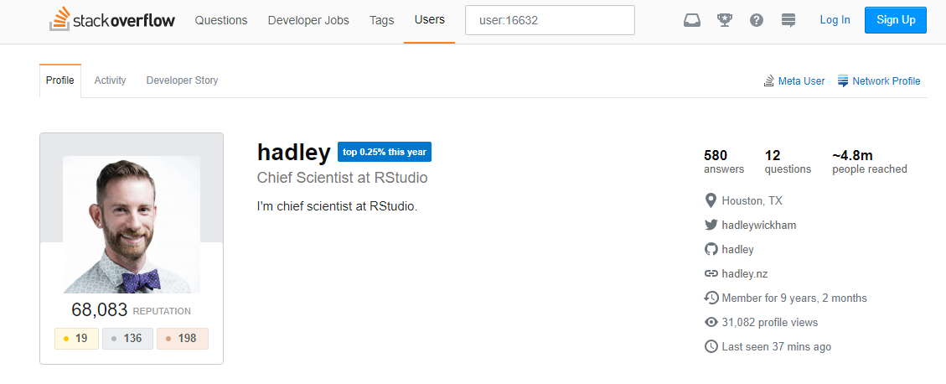
Hadley Wickham
Notes:
You might feel like you have met him before, such as from an answer to a question on stackoverflow, signed off as Hadley. His reach just on stackoverflow is estimated to be just under a 5 million.
Hadley is Chief Scientist at RStudio, a member of the R Foundation, and Adjunct Professor at Stanford University and the University of Auckland.
He builds tools to make data science easier, faster, and more fun. He has developed many packages for data science and software development
He is also a writer, educator, and speaker promoting the use of R for data science.
I for one was inspired to take on learn R from his talk earlier in the year. The fact that he is here today is testament to his dedication to the R and R-Ladies communities.

